Slide 1
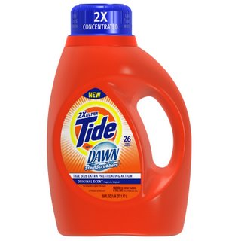

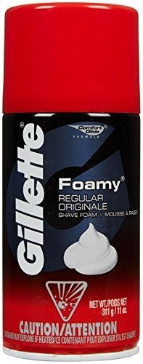
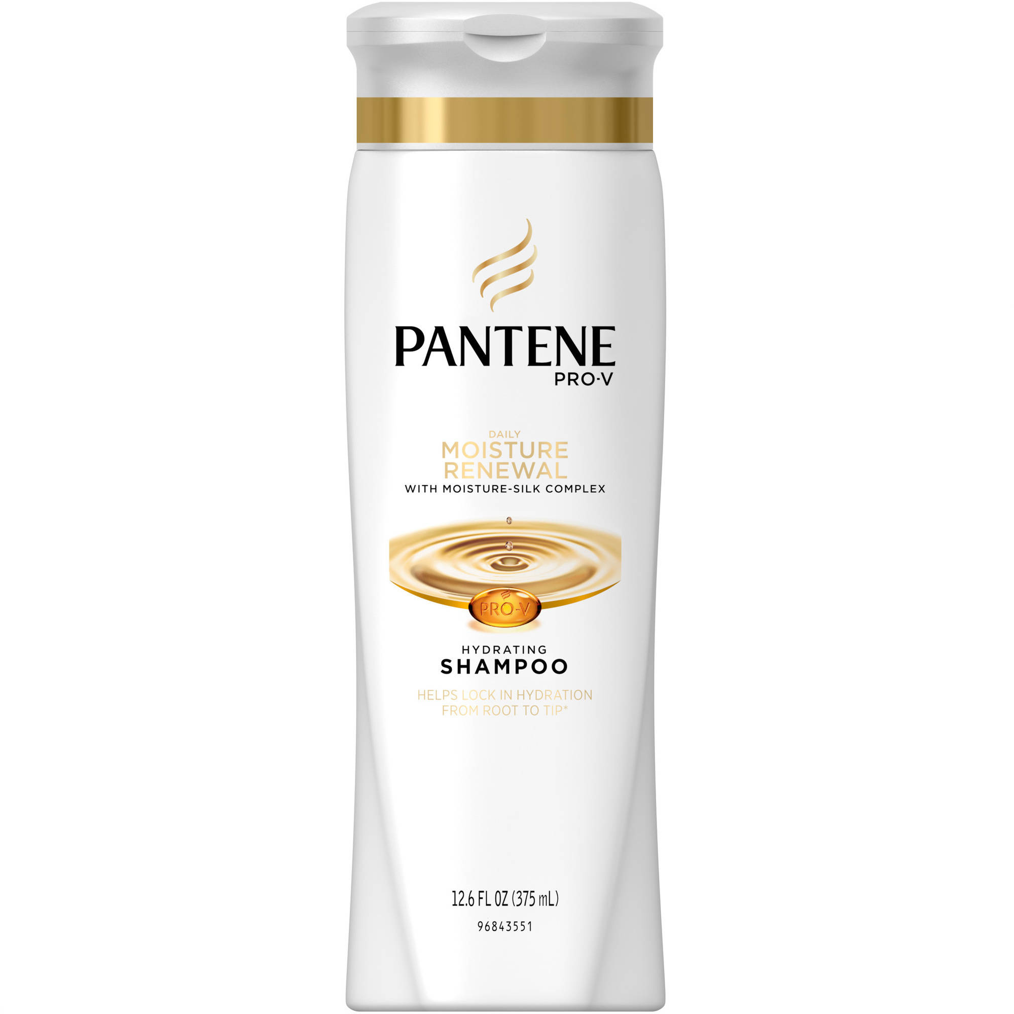
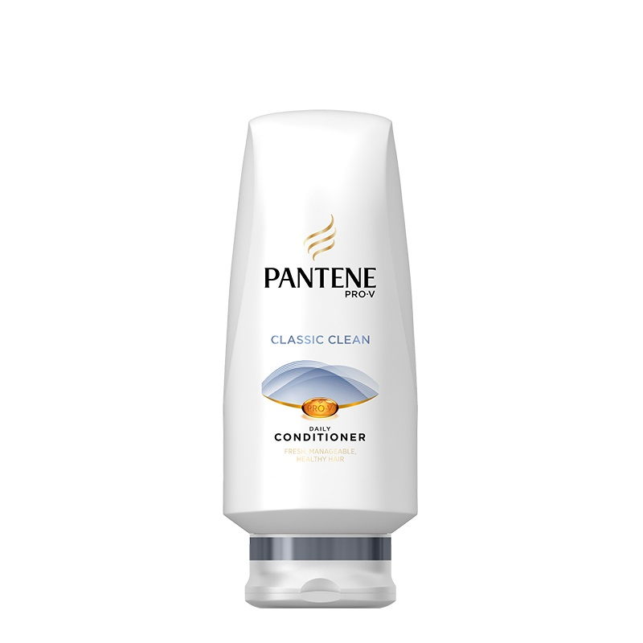
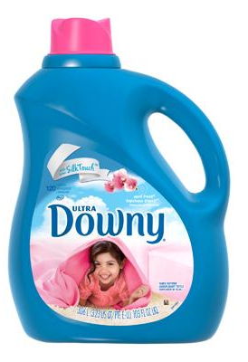
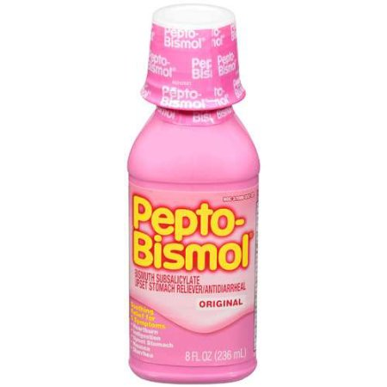


Three component model for the rheology of soft glassy materials
“Colloidal gels”
Structurant interaction
“colloidal Glasses”
“Critical gels”
Marco Caggioni, Julie Hipp, Will Hartt, Emilio Tozzi, Pat Spicer
- P&G
Veronique Trappe, Manon Marchand - University of Fribourg
Structurant volume fraction
Trappe, Veronique, and Peter Sandkühler. "Colloidal gels—low-density disordered solid-like states." Current opinion in colloid & interface science 8.6 (2004): 494-500.

Slide 2

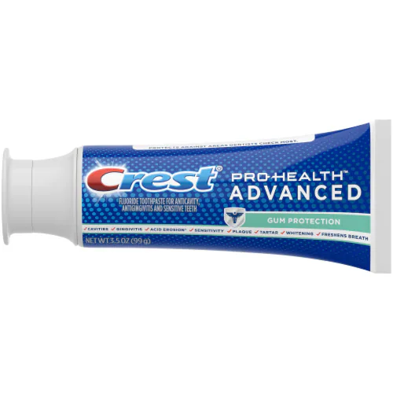
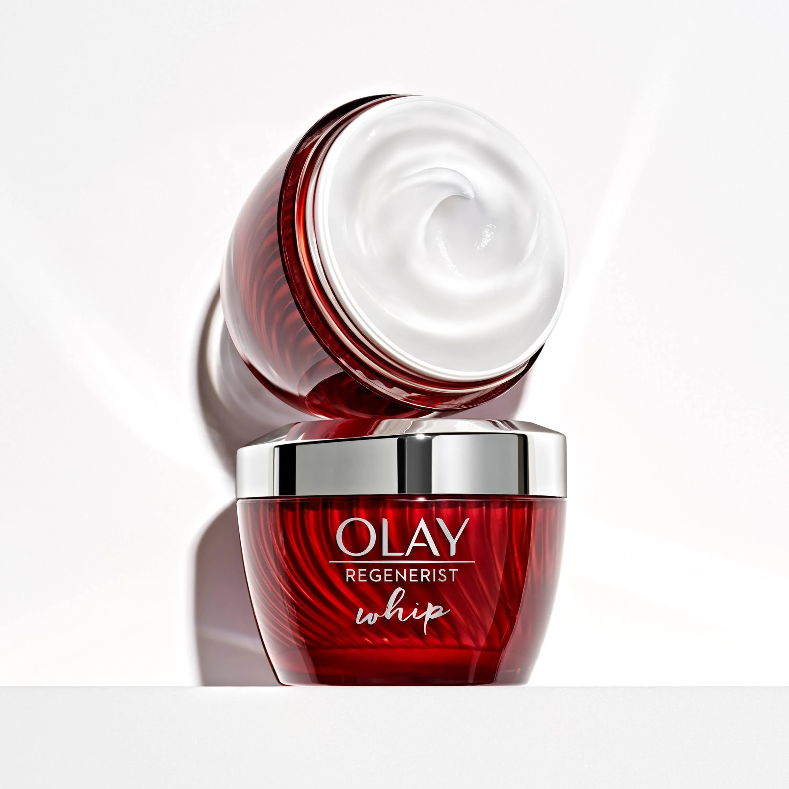
Outiline
Predicting viscosity at high shear rate
Designing new products textures
Notes:
In our role, we need to predict the rheological behavior of a wide range of complex fluids at a similarly wide range of shear rates (x to x). The products are constantly evolving to adapt to changing consumer demands.

Slide 3
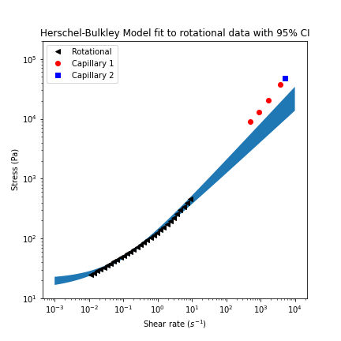
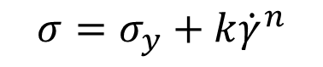
Predicting rheology at filling (~10⁴ s⁻¹)
Measure rotational rheology
Fit to yield stress fluid model
Rotational rheometer
HB fit and extrapolation (95% CI)
Capillary 1
Capillary 2
Herschel-Bulkley:
$$σ=σ_{y}+k{\dot{γ}}^{n}$$
Stress (Pa)
Filling
condition
3. Extrapolate to filling condition
Shear rate (s⁻¹)

Slide 4
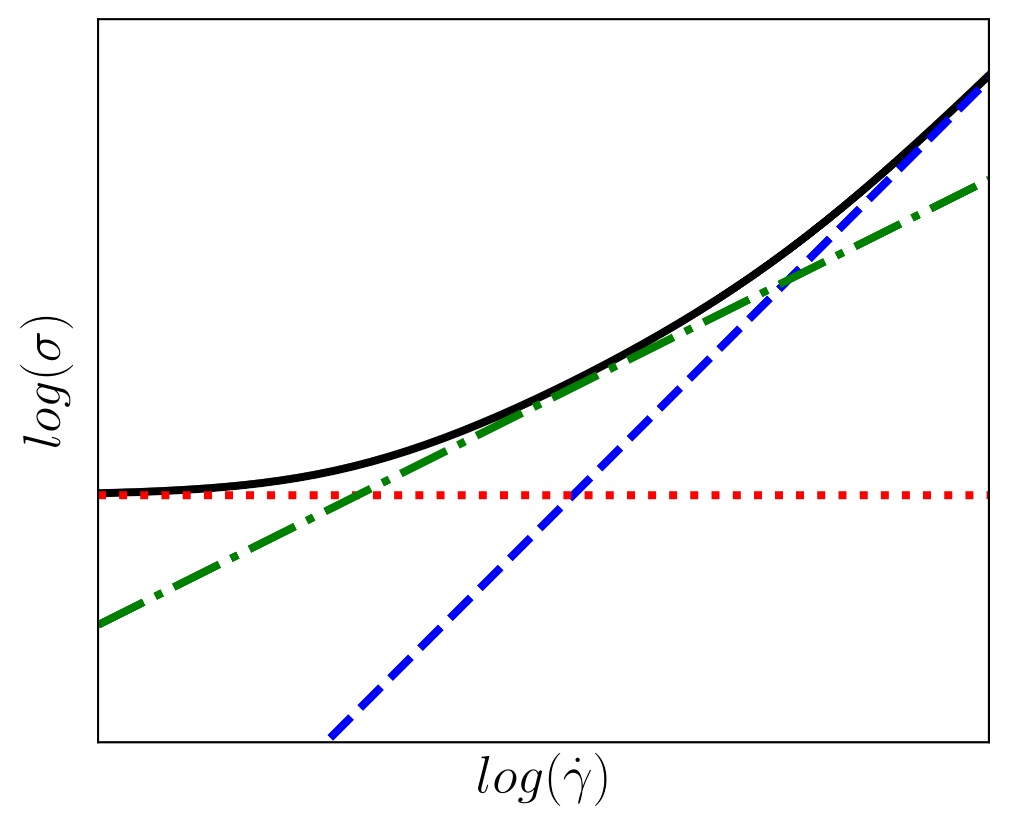
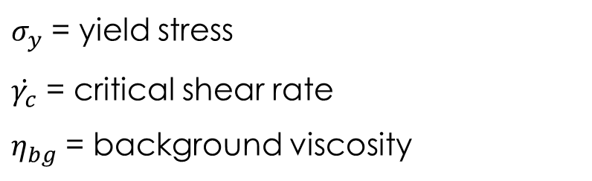
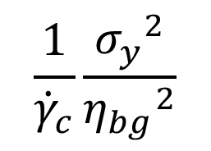
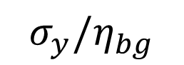

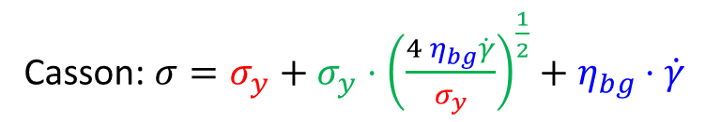
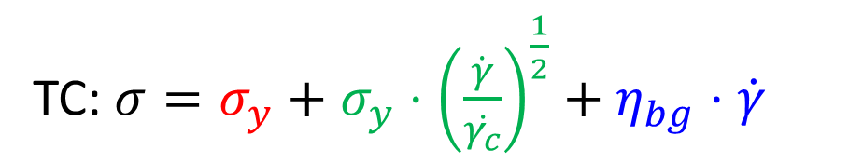
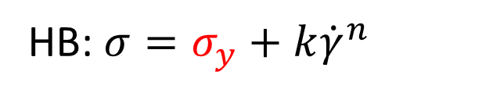
Three-component model
Caggioni, Trappe, Spicer J. Rheol. 64(2): 413-422, 2020
HB: $σ=σ_{y}+k{\dot{γ}}^{n}$
Elastic
Plastic
Viscous
TC: $σ=σ_{y}+σ_{y}⋅{\left(\frac{\dot{γ}}{\dot{γ_{c}}}\right)}^{\frac{1}{2}}+η_{bg}⋅\dot{γ}$
Casson: $σ=σ_{y}+σ_{y}⋅{\left(\frac{4 η_{bg}\dot{γ}}{σ_{y}}\right)}^{\frac{1}{2}}+η_{bg}⋅\dot{γ}$
$$\frac{1}{{\dot{γ}}_{c}}\frac{{σ_{y}}^{2}}{{η_{bg}}^{2}}$$
$σ_{y}$ = yield stress
$\dot{γ_{c}}$ = critical shear rate
$η_{bg}$ = background viscosity
$${\dot{γ}}_{c}$$
$$σ_{y}/η_{bg}$$

Slide 5
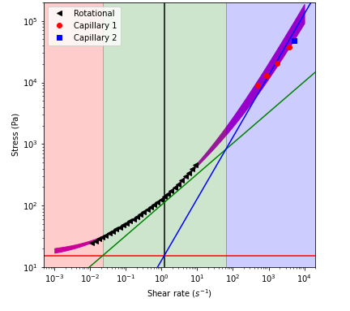
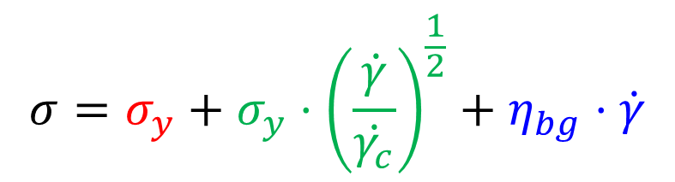
Predicting rheology at filling (~10⁴ s⁻¹)
$$σ=σ_{y}+σ_{y}⋅{\left(\frac{\dot{γ}}{\dot{γ_{c}}}\right)}^{\frac{1}{2}}+η_{bg}⋅\dot{γ}$$
Rotational rheometer
TC fit and extrapolation (95% CI)
Capillary 2
Capillary 1
Stress (Pa)
How did we miss this?
The model systems may have biased the model
Shear rate (s⁻¹)

Slide 6
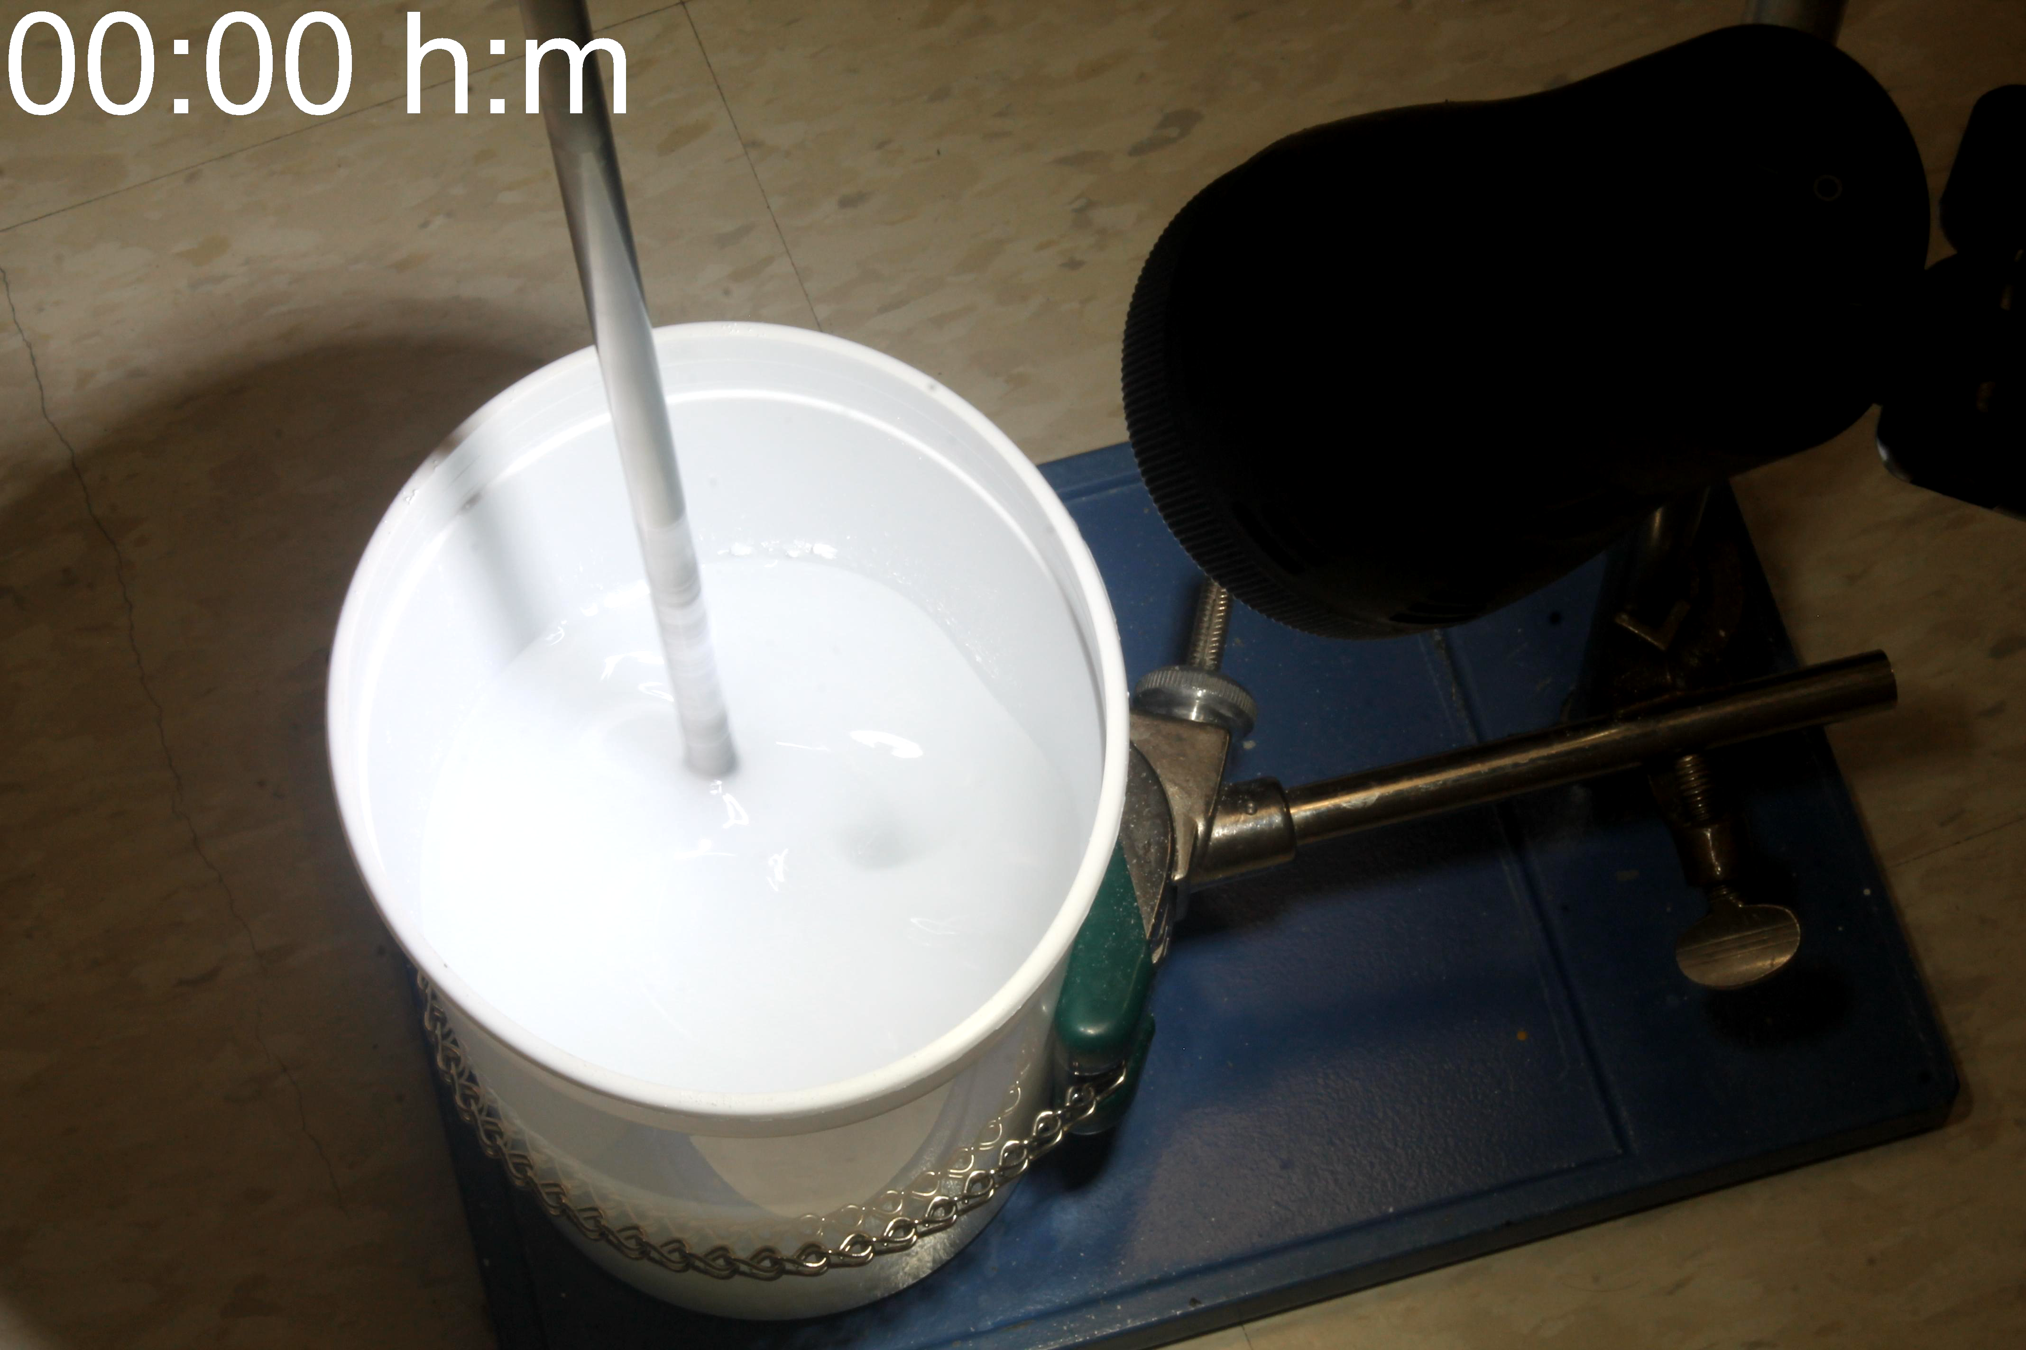
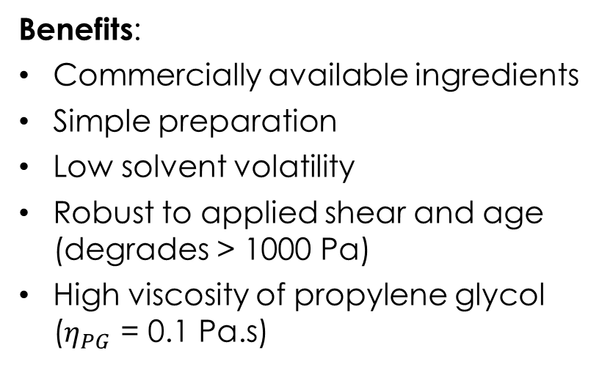
Model System: propylene glycol + carbopol
Benefits:
Commercially available ingredients
Simple preparation
Low solvent volatility
Robust to applied shear and age (degrades > 1000 Pa)
High viscosity of propylene glycol ($η_{PG}$ = 0.1 Pa.s)
Mixing with pitch blade impeller at 200 rpm
Notes:
We prepare a microgel suspension of 2% Carbopol (974P NF) and (Ultrez) w/w in Propylen glycol. To prepare the sample we add 20g of carbopol to 1980g of Propylen glycol while mixing with a pitched blade impeller at ~200 rpm. We allow the sample to equilibrate for 24 to 48 h at room temperature continuing mixing at ~200 rpm.

Slide 7
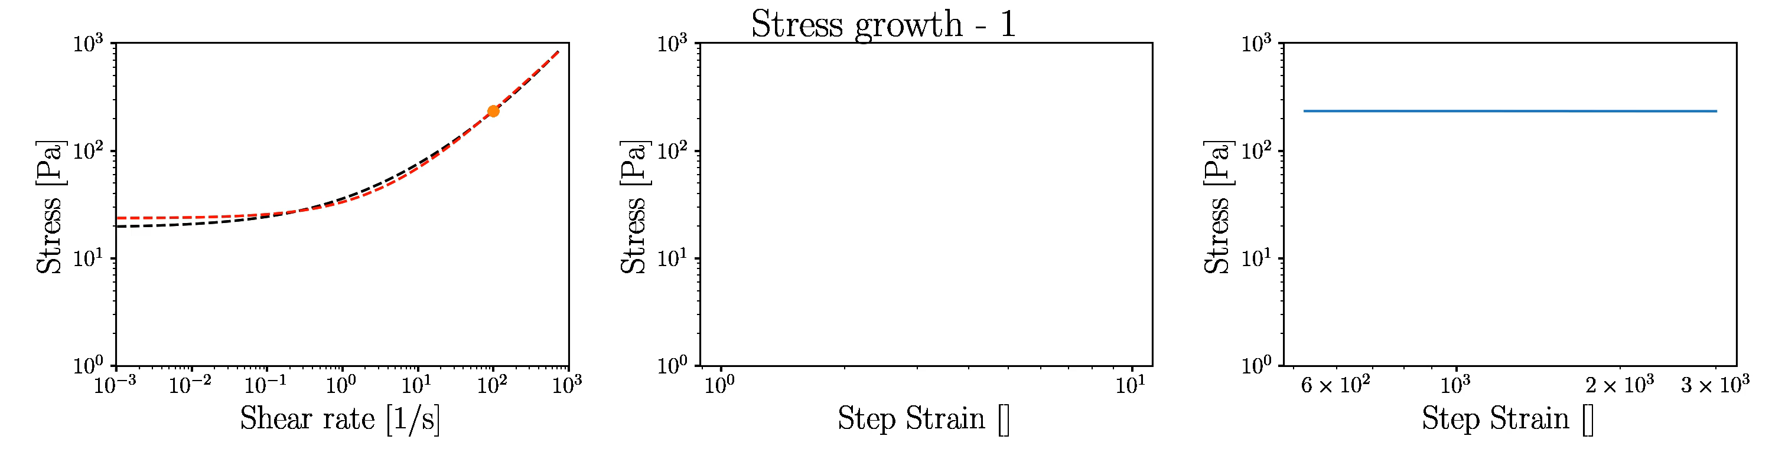
It’s like a simulation!
~20h

Slide 8
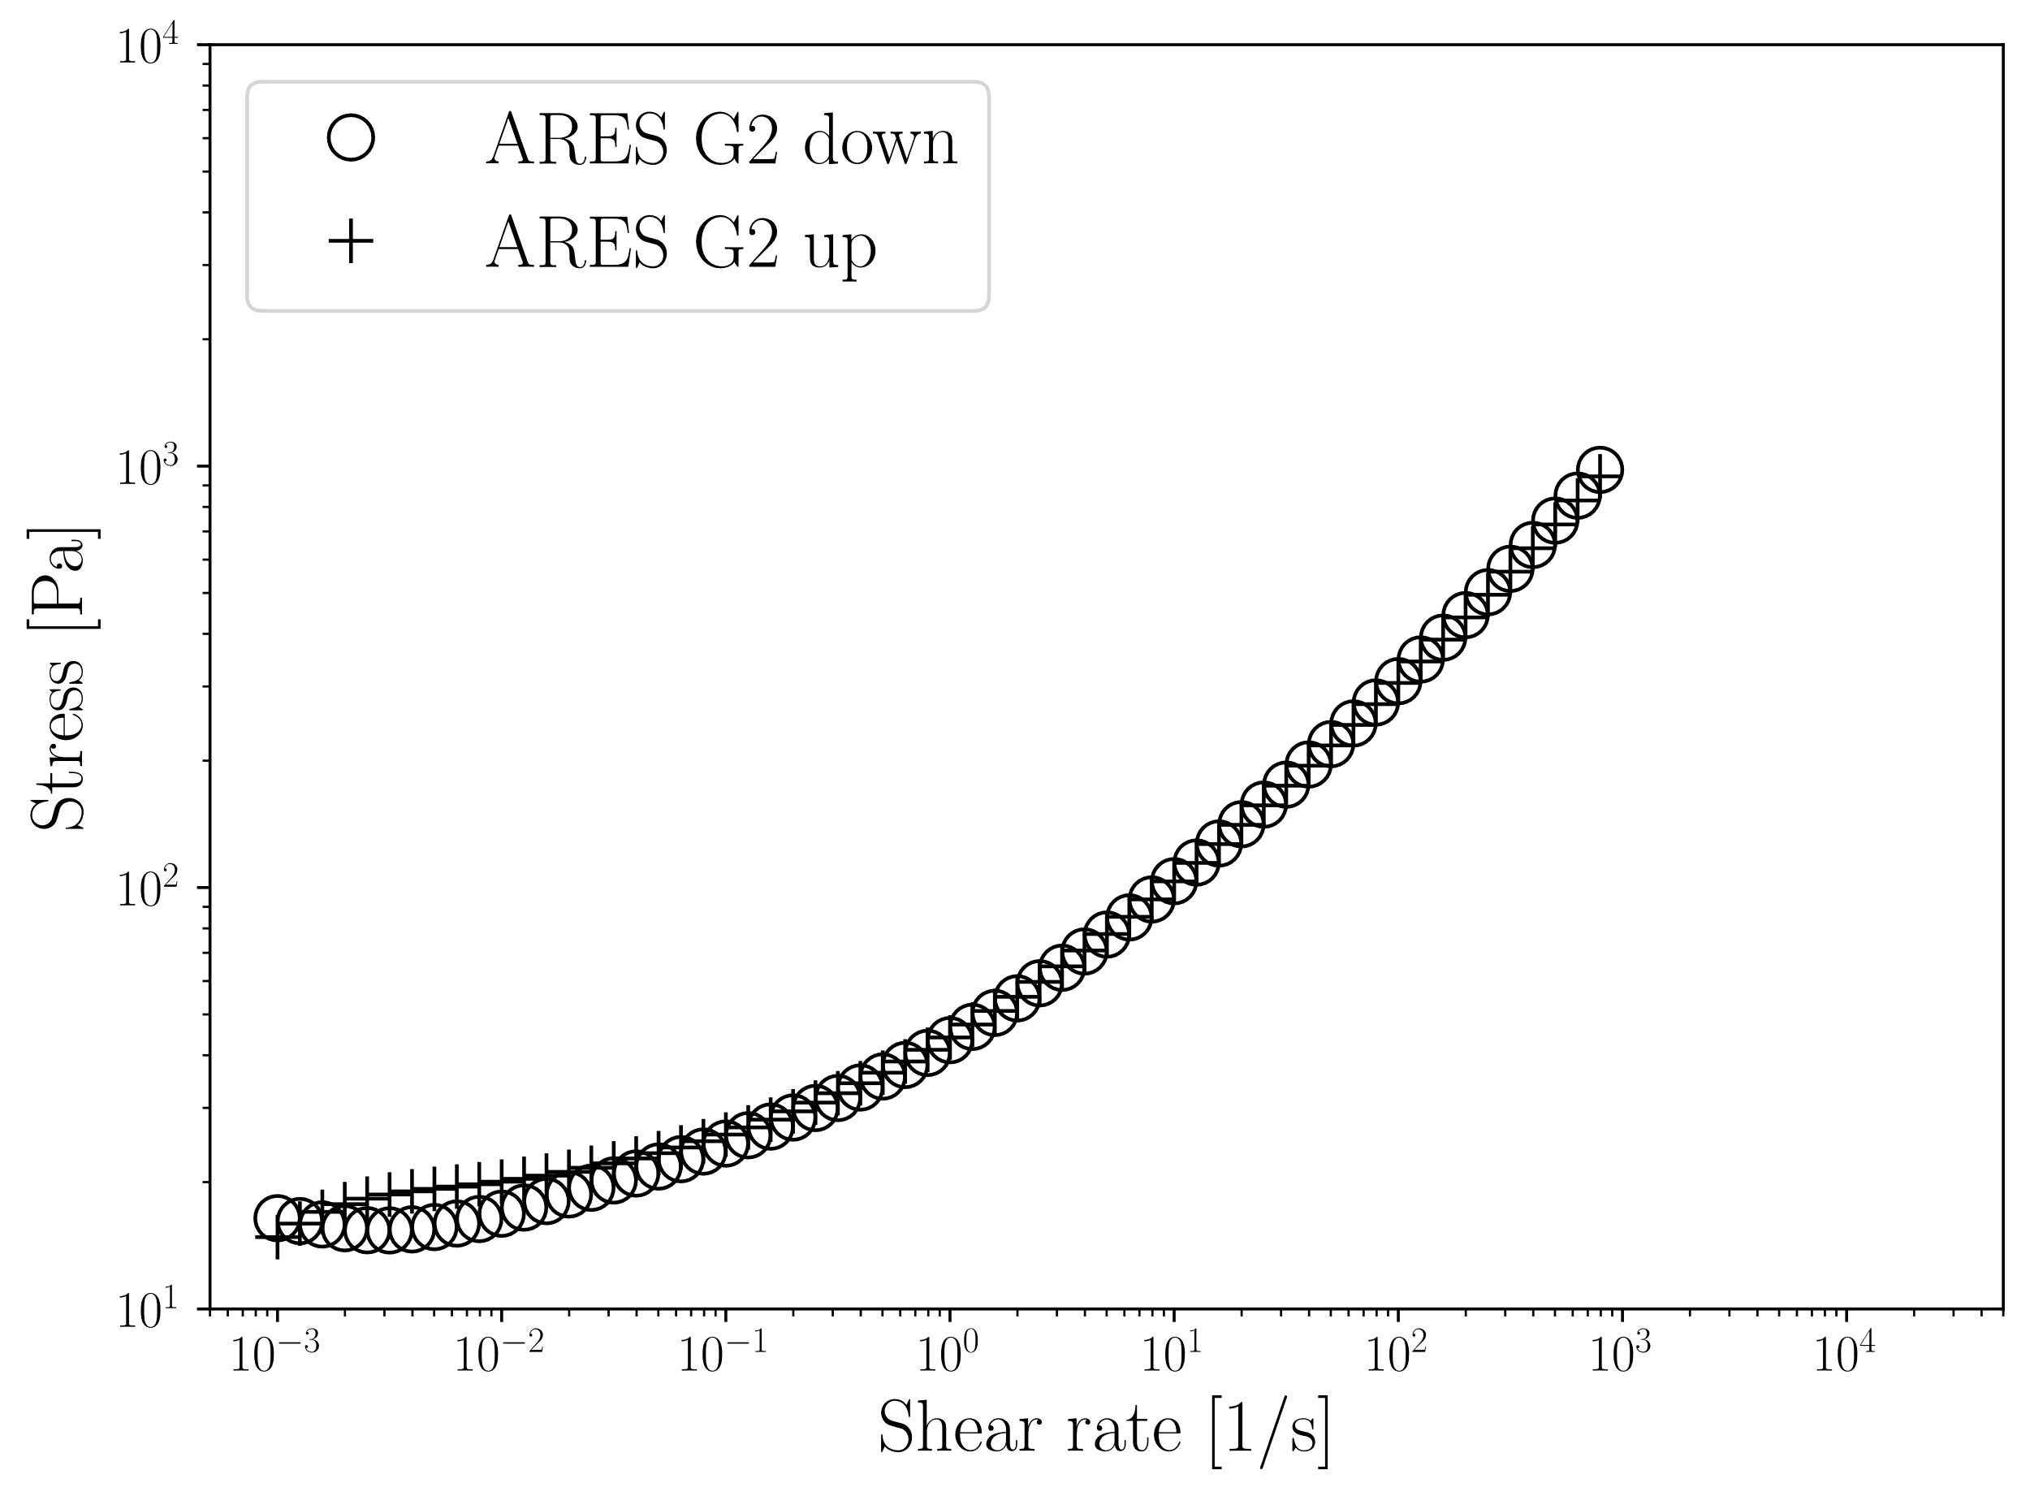
Reproducible steady shear rheology

Slide 9
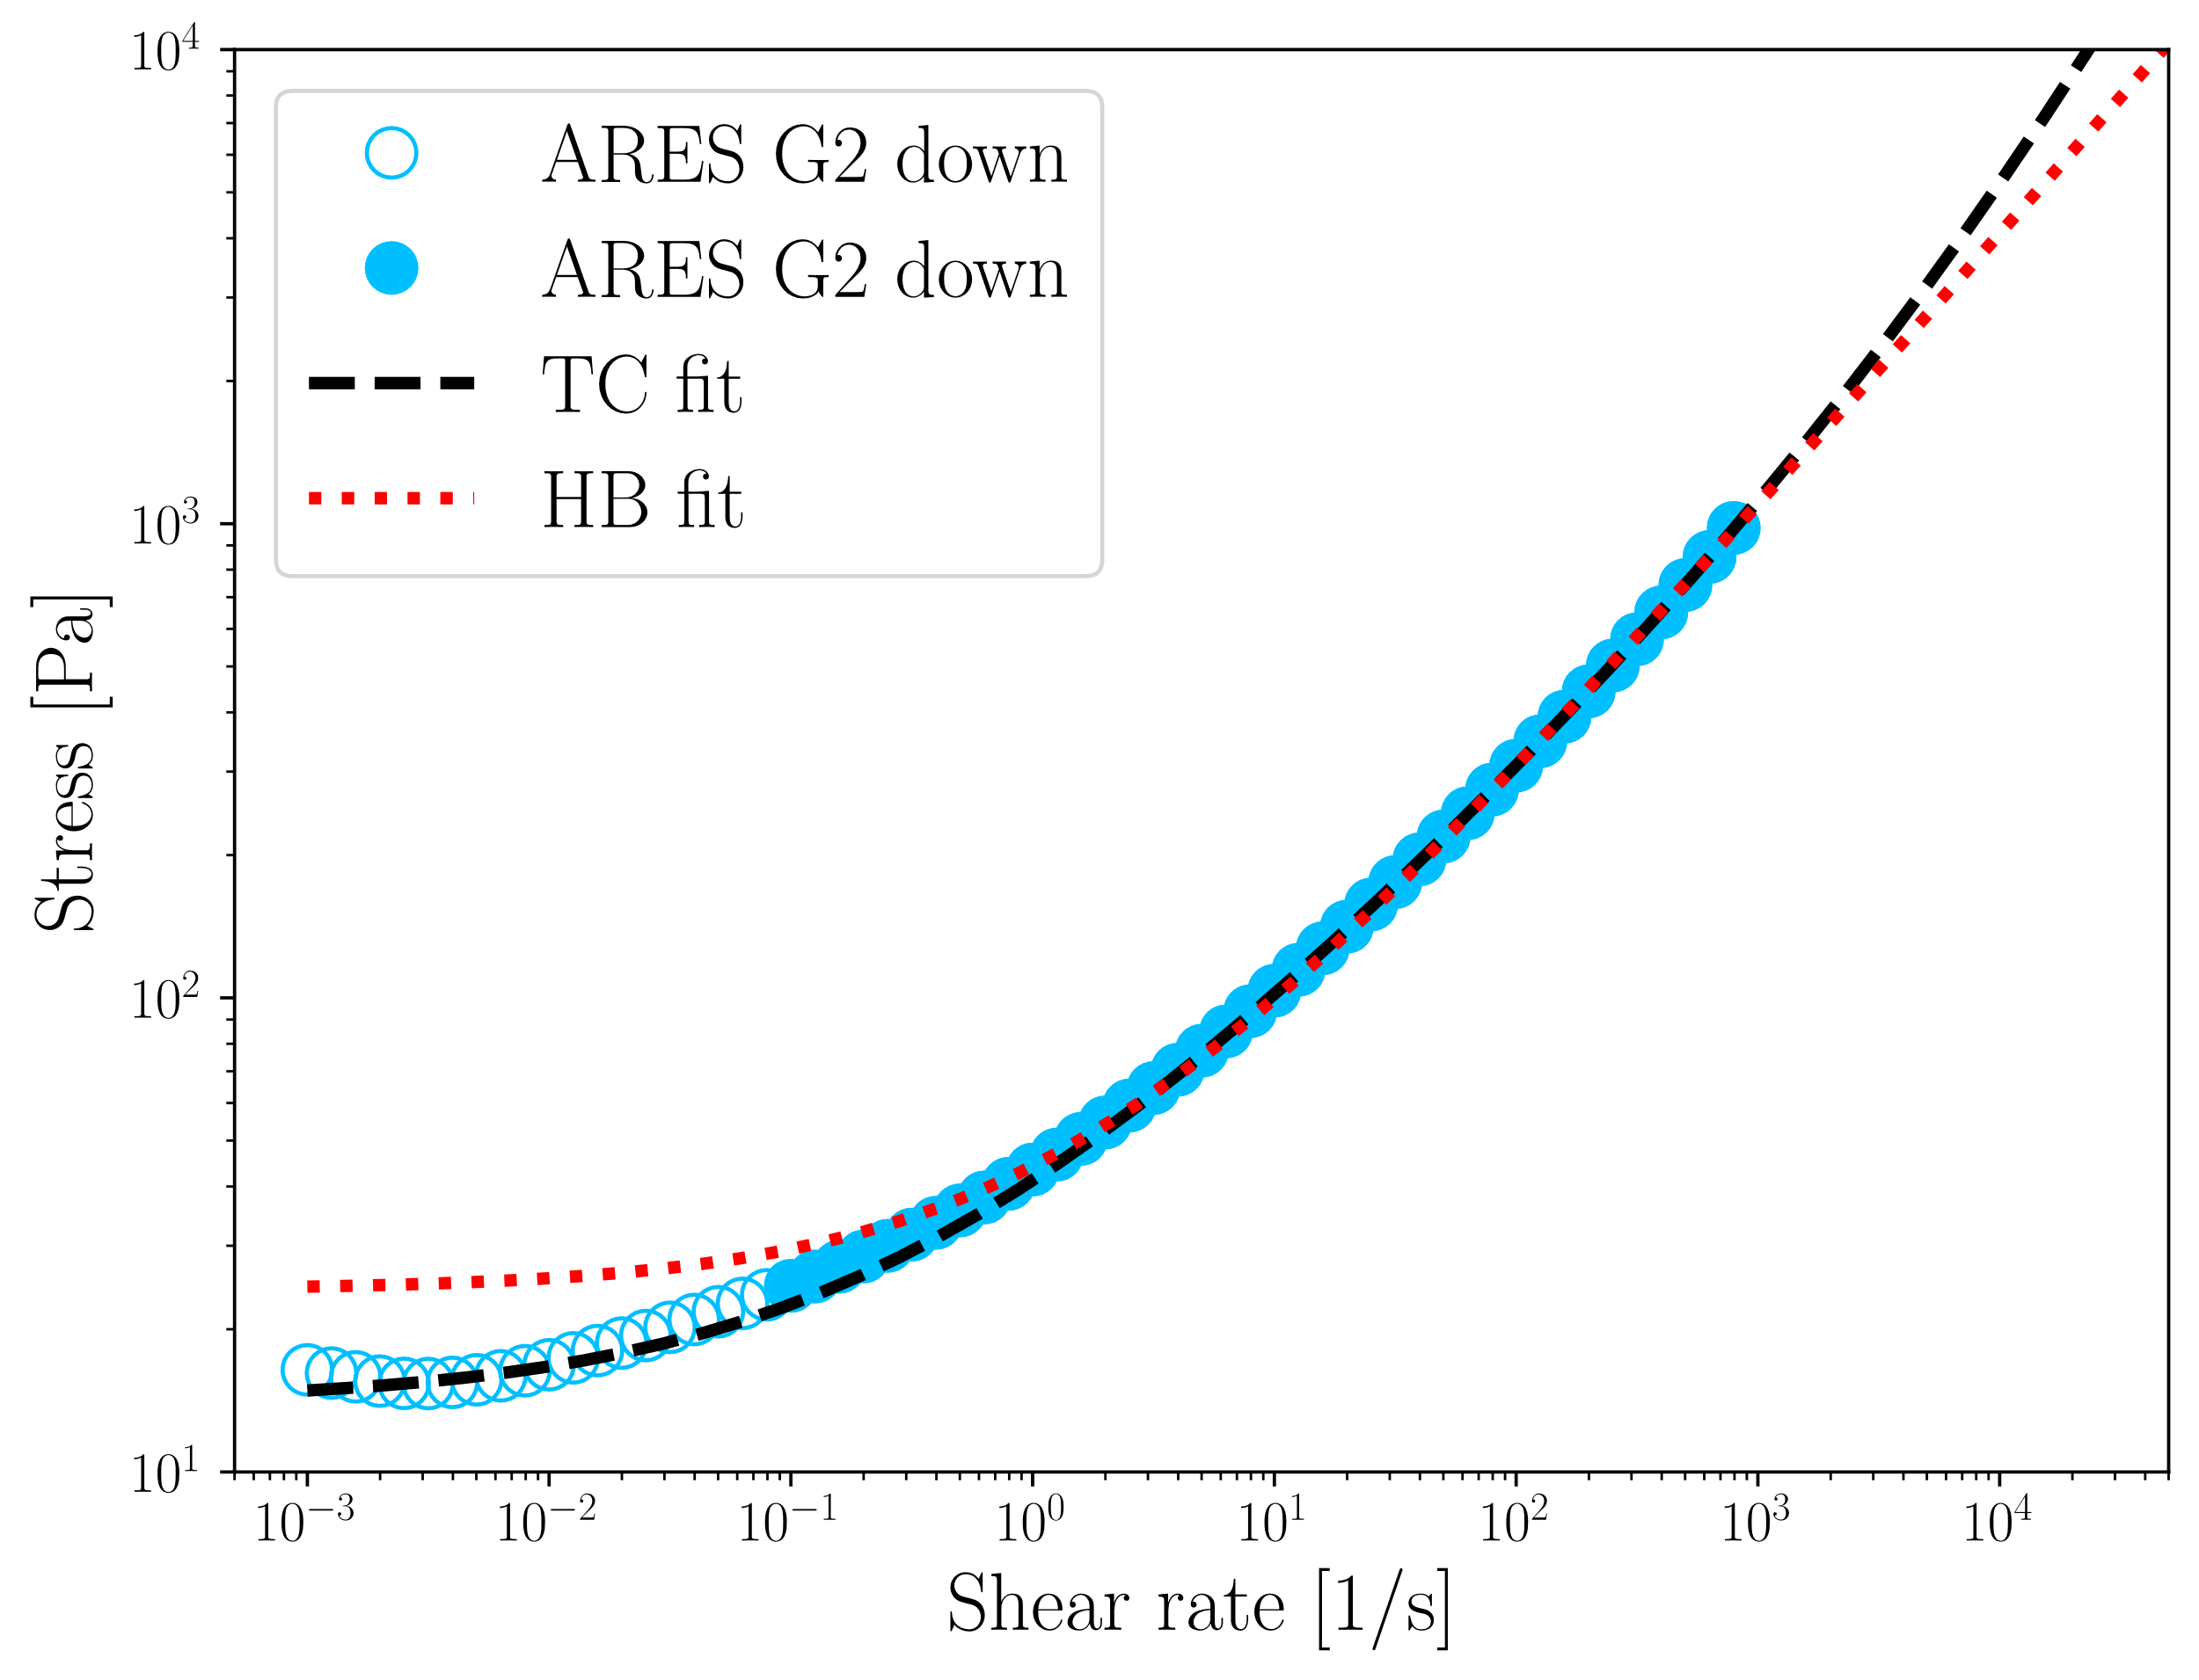
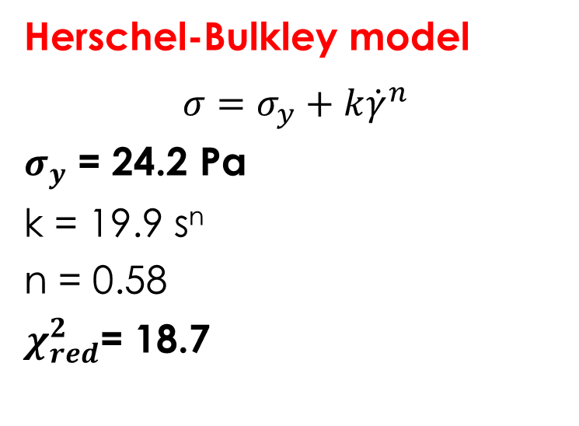
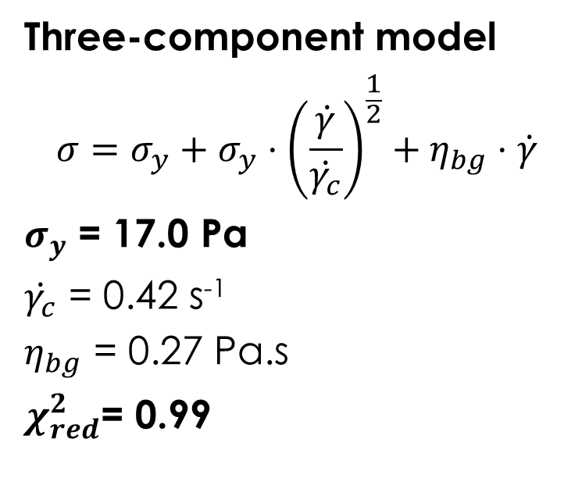
Comparing model fits
Herschel-Bulkley model
$$σ=σ_{y}+k{\dot{γ}}^{n}$$
$σ_{y}$ = 24.2 Pa
k = 19.9 s^{n}
n = 0.58
$χ_{red}^{2}$= 18.7
Three-component model
$$σ=σ_{y}+σ_{y}⋅{\left(\frac{\dot{γ}}{\dot{γ_{c}}}\right)}^{\frac{1}{2}}+η_{bg}⋅\dot{γ}$$
$σ_{y}$ = 17.0 Pa
$\dot{γ_{c}}$ = 0.42 s⁻¹
$η_{bg}$ = 0.27 Pa.s
$χ_{red}^{2}$= 0.99

Slide 10
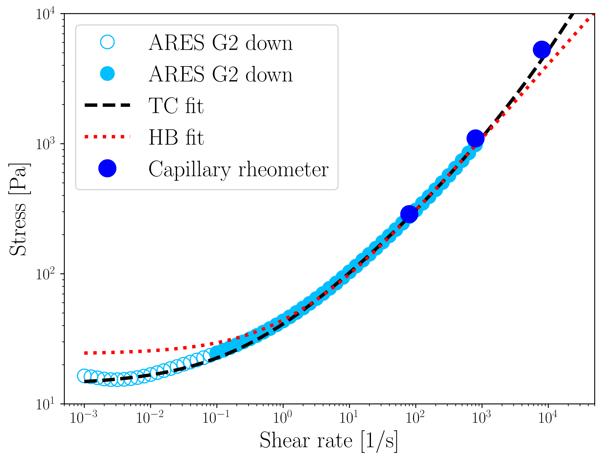
Extrapolation to high shear rates
TC closer
HB underpredicts

Slide 11
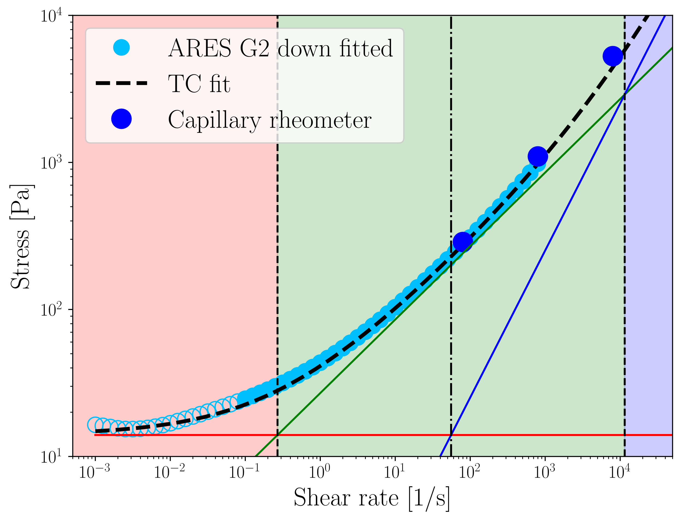
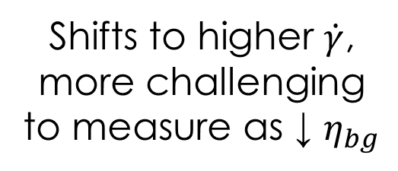
3 scaling better than 2
Elastic
Plastic
Viscous
Shifts to higher $\dot{γ}$, more challenging to measure as ↓ $η_{bg}$

Slide 12
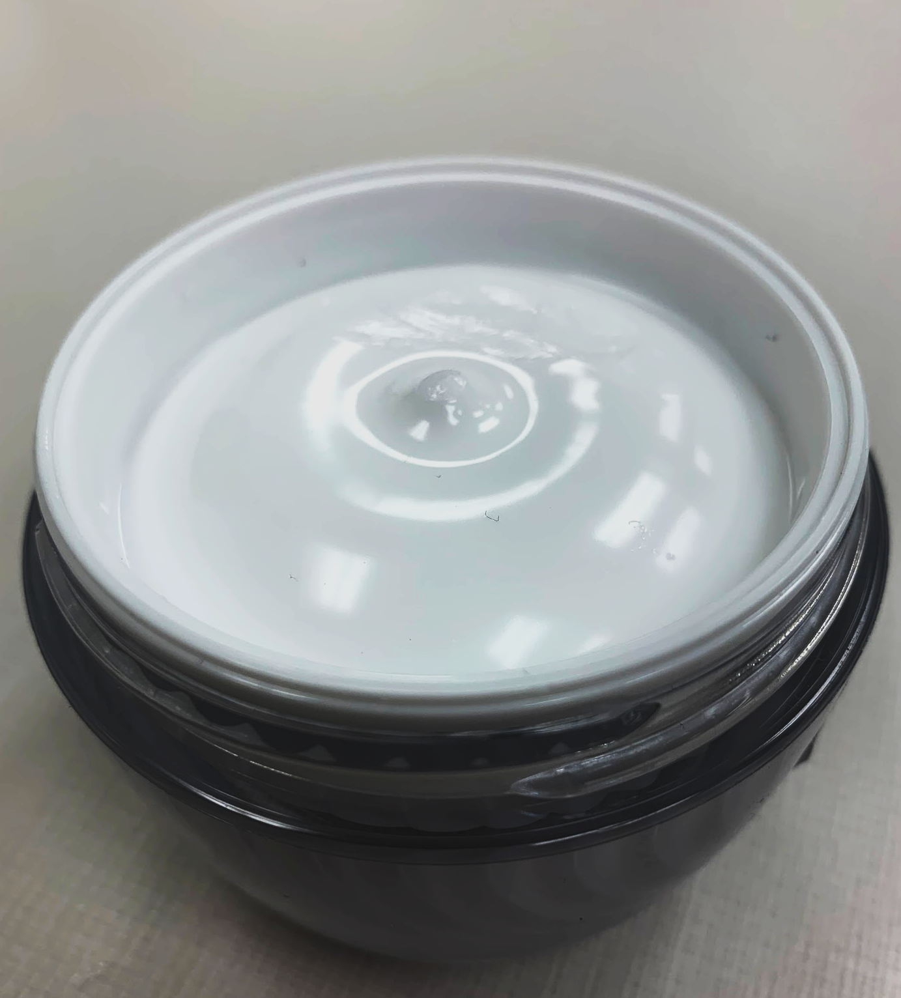
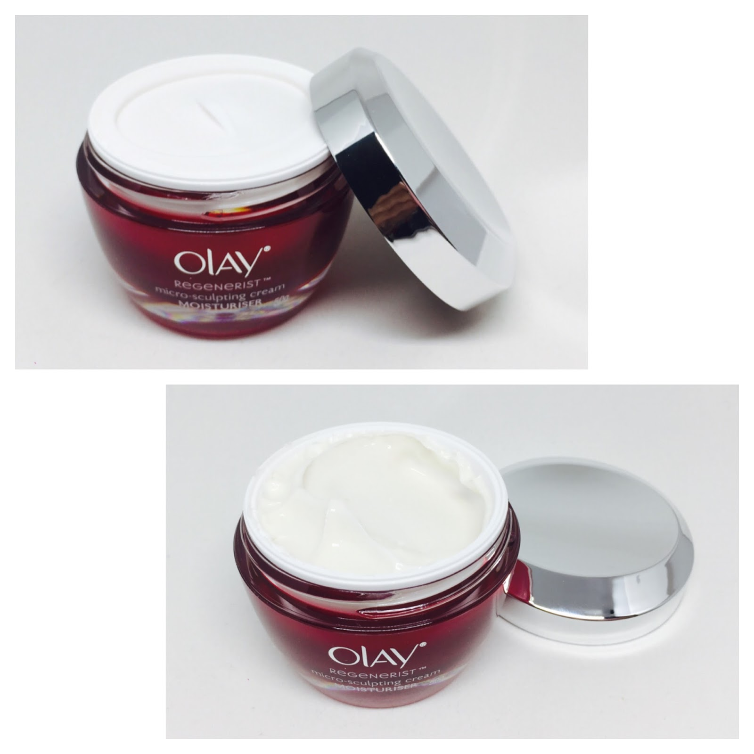
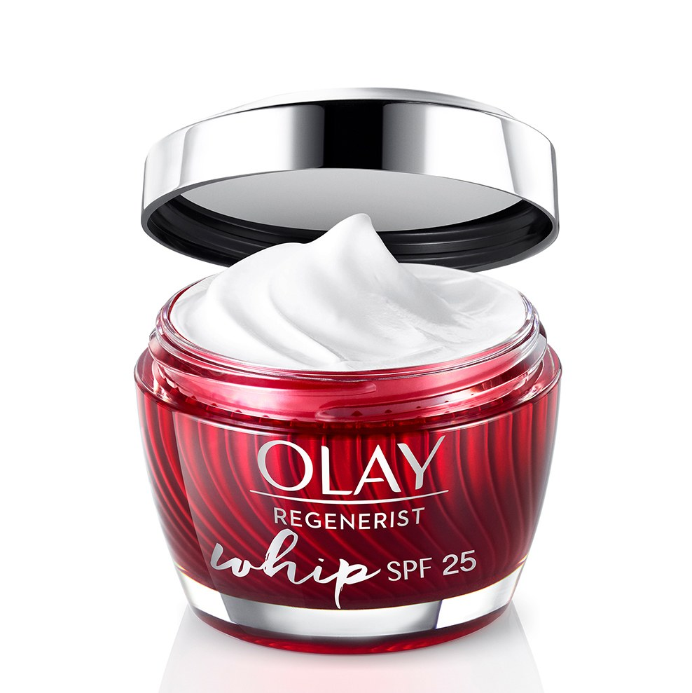
Designing product texture
Olay “Butter”
Olay “Cream”
Olay “Whip”

Slide 13
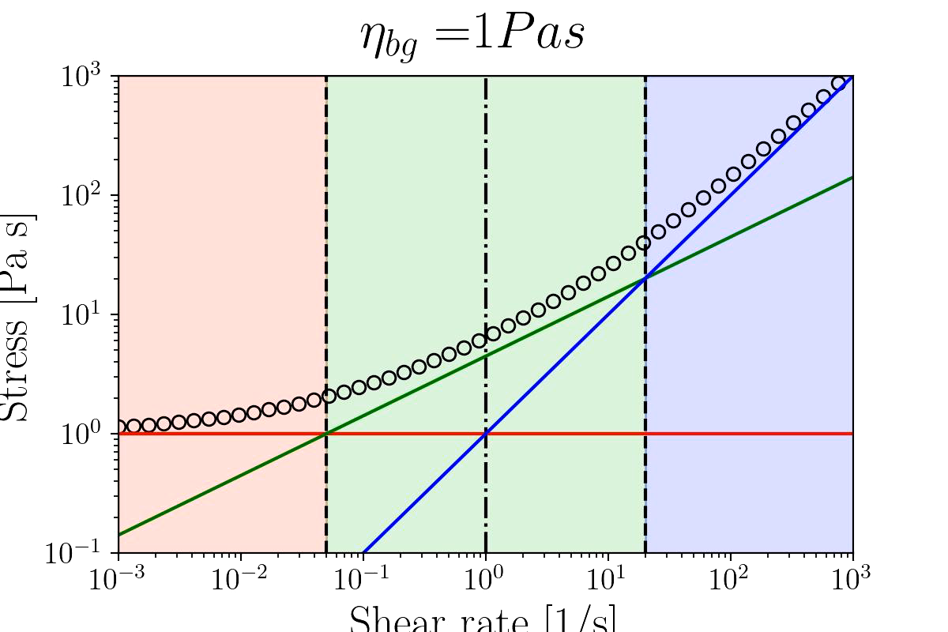

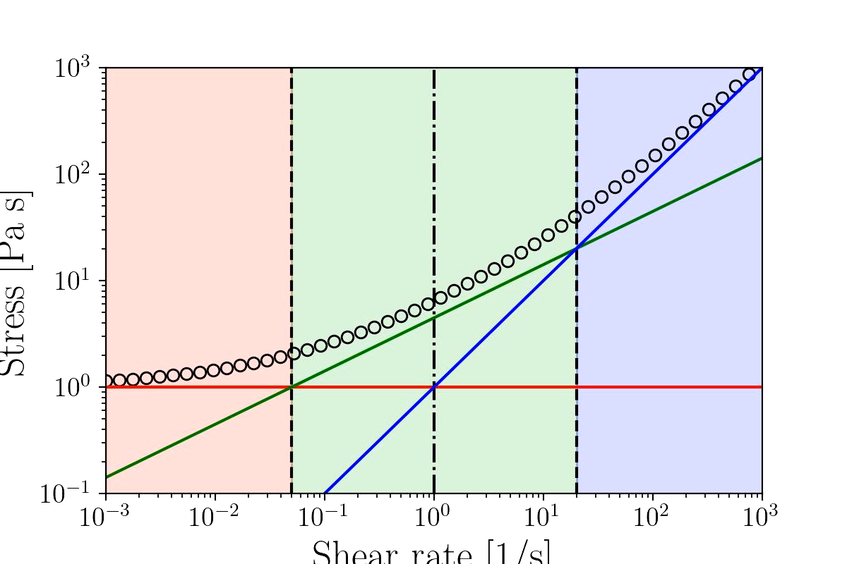
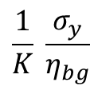
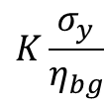
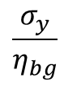
Designing new products textures
$$K\frac{σ_{y}}{η_{bg}}$$
$$\frac{σ_{y}}{η_{bg}}$$
$$\frac{1}{K} \frac{σ_{y}}{η_{bg}}$$
Tune solvent viscosity
Tune volume fraction

Slide 14
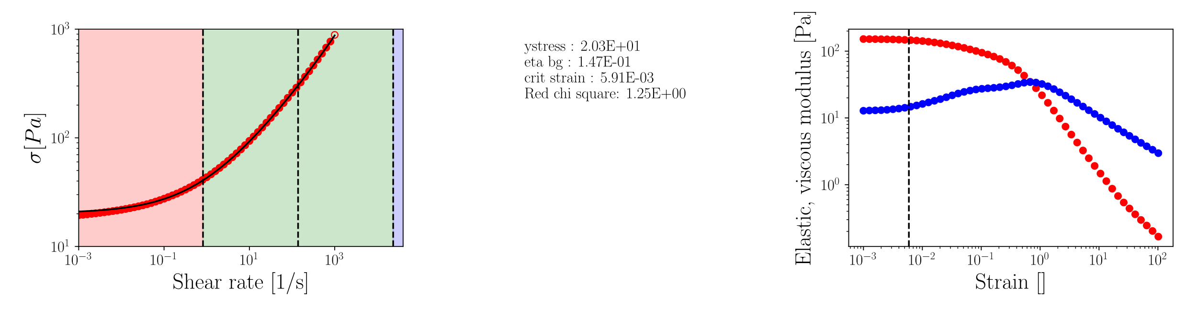
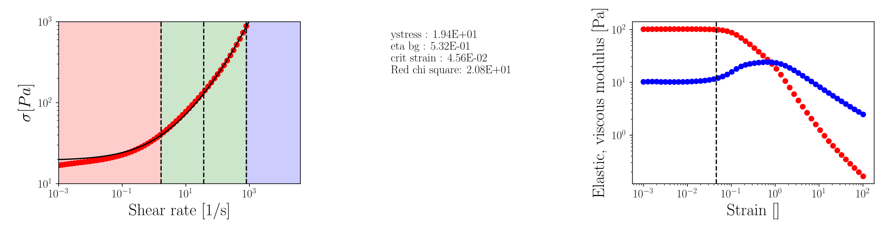
K=0.005
2% Carbopol 974 in PG @ 25C
K=0.045
2% Carbopol Ultrez21 in PG @ 25C

Slide 15

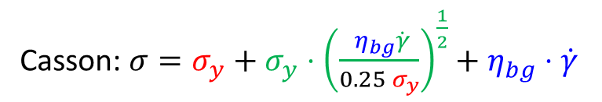
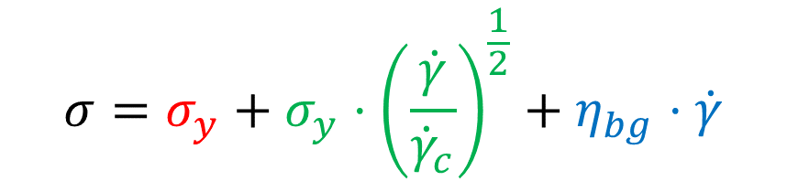
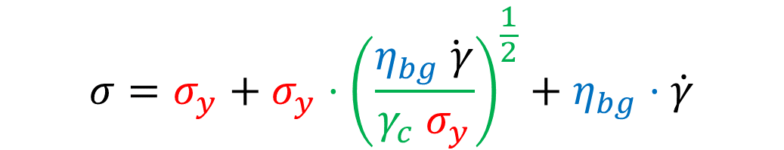
Connecting flow and oscillatory data
$$σ=σ_{y}+σ_{y}⋅{\left(\frac{\dot{γ}}{{\dot{γ}}_{c}}\right)}^{\frac{1}{2}}+η_{bg}⋅\dot{γ}$$
$$σ=σ_{y}+σ_{y}⋅{\left(\frac{η_{bg}\dot{ γ}}{γ_{c} σ_{y}}\right)}^{\frac{1}{2}}+η_{bg}⋅\dot{γ}$$
$${\dot{γ}}_{c}=γ_{c}{⋅σ}_{y}/η_{bg}$$
Casson: $σ=σ_{y}+σ_{y}⋅{\left(\frac{ η_{bg}\dot{γ}}{{0.25 σ}_{y}}\right)}^{\frac{1}{2}}+η_{bg}⋅\dot{γ}$
Casson would become TC model with 25% critical strain
Seth, Jyoti R., et al. "A micromechanical model to predict the flow of soft particle glasses." Nature materials 10.11 (2011): 838-843.

Slide 16
Summary
Describing flow curve with 3 regimes seems better than with 2
The water based Carbopol model system may have biased the model development
TC model provides intuitive connection between parameters and microstructure
Provides insight on how to tune material properties
We observe an interesting connection between yield strain and flow properties
Work in progress

